Slide 1
Conceptual and logical data model
Group 3

Slide 2
Conceptual model
Can access
all kinds of graphs
(0,n)
statistics
Amsterdam
Login ID
Password
pages
Can create
(1,1)
(1,1)
Has a
(0,n)
Has many
Website
database
(0,n)
International Visitors
Has many
PagesVisited VisitOrder
Are stored in
Name Country ID
(0,n)
(0,n)
The Rules and Law
d
(0,n)
(0,n)
(0,n)
(0,n)
Law on drugs
Law on Alcohol
Red light district
Common Rules
Name ID Legal Carry amount when overdoses legal
Name ID Percentage When overdoses
Rule Punishment
Law Punishment

Slide 3
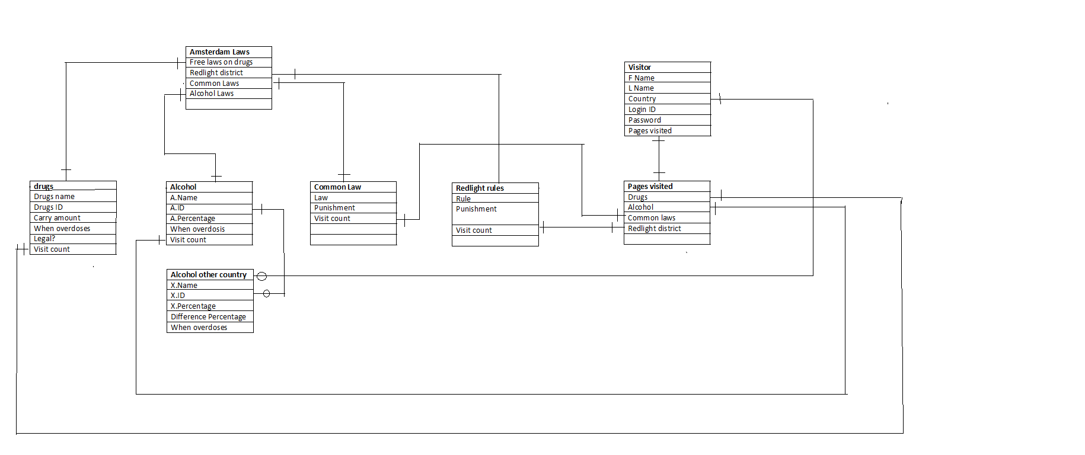
Draft of logical model

